Slide 1
Dementia Friendly Hospital and Comfort Companions

Slide 2
Objectives
Dementia Facts
Why Dementia Friendly?
Patient Identifiers
Comfort Companions

Slide 3
Dementia Facts
Some sort of dementia affects 5.4 million in the United States.
6th leading cause of death in the United States.
Over 170,000 people in North Carolina are affected by Alzheimer's and the numbers are expected to increase to approx. 210,000 by 2025.
25% of Vidant Chowan’s inpatient admissions, older than 75 yrs. old, have a secondary diagnosis of dementia.

Slide 4
Why Dementia Friendly?
Everyone needs to have a sense of meaning in life
Dementia friendly offers self confidence, contribution, participation
Those living with dementia are worried about becoming confused, getting lost, fear the reaction of others

Slide 5
Fears and Focus
Dementia fear causes lowered perceived status within the community which leads to a sense of shame and inadequacy, low self esteem, and depression.
This type of fear causes isolation for both the person living with dementia and their caregiver.
Dementia friendly focuses on the strengths and abilities rather than on limitations.
This gives the person living with dementia a sense of belonging, feeling valued and understood.

Slide 6
What does building ‘dementia friendly’ look like?
Enables individuals:
Find their way around and be safe
Access local businesses that they are used to and where they are known
Maintain social networks; to feel a sense of belonging
A community where individuals:
Have the ability to live as independently as possible
Continues to be a part of their community
Are met with understanding
Are given support when necessary
Builds infrastructure
Increases public awareness
Creates environments that calm and reduce anxiety of the person with dementia
Dementia friendly businesses – restaurants, churches, etc.

Slide 7
Dementia Friendly Hospital
Vidant Chowan’s goal is not the diagnosis of dementia/cognitive disorder, but to raise awareness of dementia symptoms to staff that may effect patient care.
Vidant Chowan developed a curriculum to provide education to hospital staff in order to improve care and decrease associated risks for patients/visitors with dementia/cognitive disorders in the acute care setting.
A dementia friendly hospital looks through the eyes of a person with dementia; then strives to provide a safe environment where they are valued and respected.

Slide 8
Global Signal for Dementia/Alzheimer’s
Global, visible symbol for a patient at risk for cognitive impairment – designed by Norman McNamara of the UK
Purple is the national color recognizing Dementia/Alzheimer’s disease
Magnets with this symbol will be placed on the patients door for easier identification

Slide 9
Other Patient Identifiers / Tools
All About Me
Purple Placemats
Book list
Busy Bags

Slide 10
Comfort Companion Role
Patient Companion Volunteers are available to sit with patients, who have dementia, and do not have family with them or if the family needs a break. Please note, we may not be able to meet all the needs, but will make every effort to cover as many hours as possible. The volunteer should always check in with the charge nurse and is aware to escalate any concerns – the volunteer may also hand-off information during shift change.
What Volunteers CAN do:
Provide emotional support to patents and families
Redirect behaviors by using the tools provided such as music, dolls, etc.
Use warm wash clothes to wash hands and face
Feed patients – as long as there are no swallowing issues
Walk – as long as the patient is not a fall risk
What Volunteers CANNOT do:
Replace the role of clinical staff
Help with personal hygiene (bathing, restroom, dressing)
Lifting – providing physical assistance to turn patients

Slide 11
Comfort Companion Workflow
Dementia Comfort Companions will receive Dementia Friendly Essentials training which includes Dementia Basics, Dementia Friendly Hospital rationale and initiatives, Hand Under Hand and Positive Approach to Care techniques, along with Practical Tips in Caring for someone with dementia.
Dementia Comfort Companions will not replace the role of Clinical Staff, help with personal hygiene needs (bathing, restroom, and dressing), lift or provide physical assistance in turning and repositioning patients
WORKFLOW
INFORM: inform nursing staff when companion arrives & when leaving
REPORT: Report to nurse if there are any updates/changes pertaining to patient
SUPPORT: Provide emotional support to patients, families and caregivers
GET TO KNOW ME: Review “All About Me” document & use this information to interact
with patient. This document is located on the inside door of the clothes
closet on Med/Surg and ICU units.
ENGAGE: When appropriate, engage patients in activities in “Busy Bags”
Dementia Comfort Companions will be trained in all the above roles and responsibilities, as well as reinforcement of skills taught during their previously attended Dementia Friendly Essentials Training. The Hospital Volunteer Department will be facilitating these responsibilities/dementia reinforcement sessions.
Dementia Comfort Companions will not:
Replace the role of Clinical Staff
Help with personal hygiene needs (bathing, restroom, and dressing)
Lift or provide physical assistance in turning and repositioning patients

Slide 12
Workflow cont.
HYGIENE: Use warm wash clothes to wash the patient’s hands and face.
HYDRATE/NOURISH: Discuss with nurse before feeding – Companions can feed **as
long as there are no swallowing issues** Use Hand under Hand technique when
feeding patient.
AMBULATE: Discuss with nurse before beginning – Companions can walk with
patients as long as the patient is NOT a fall risk. Use Hand under Hand technique
when walking.
SOOTH: Use TV Music Channels to create a calm environment.
Dementia Comfort Companions will be trained in all the above roles and responsibilities, as well as reinforcement of skills taught during their previously attended Dementia Friendly Essentials Training. The Hospital Volunteer Department will be facilitating these responsibilities/dementia reinforcement sessions.

Slide 13
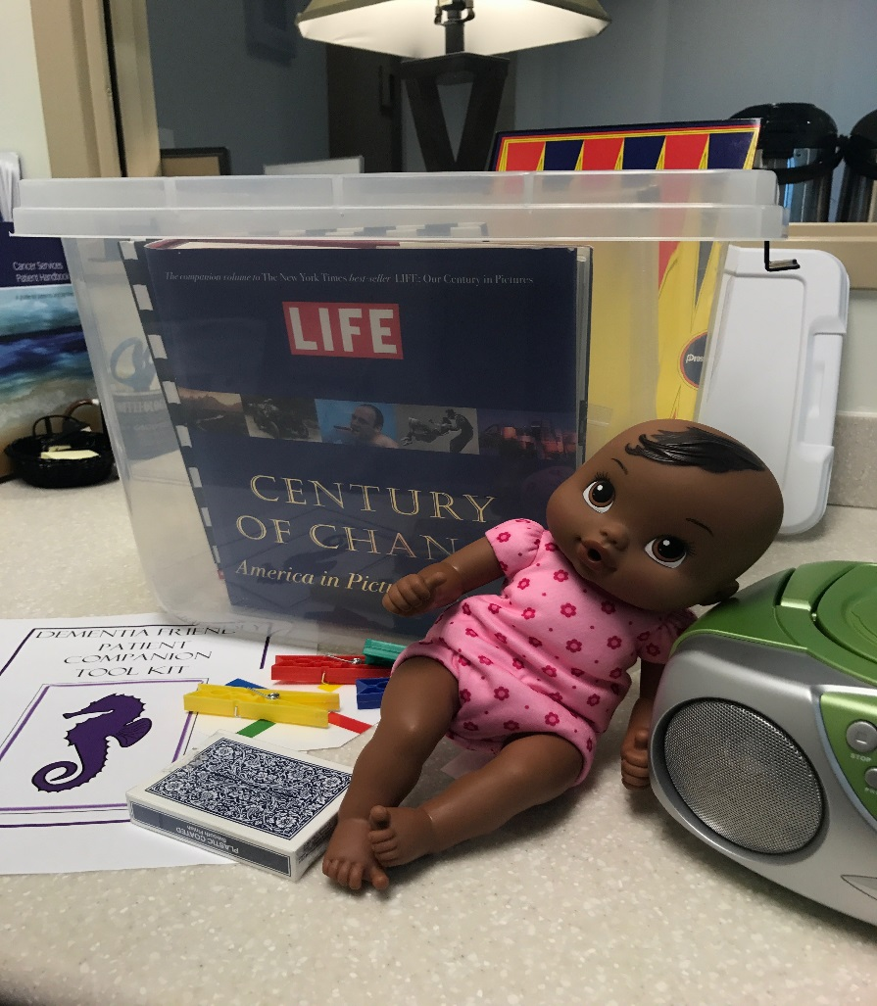
Comfort Companion Tool Kit
Contents:
* Music – can be soothing-consider playing music, singing/humming and rocking
- cd player and cds
Games (disposable) –use to provide entertainment and enrichment
- playing cards, backgammon, match the pins
Books – reading the patient and showing history pictures can be comforting – patients should not touch books, unless they are disposable
- nursery rhymes, Life – Century of Change
Coloring books and crayons – use for distraction and enrichment
Baby Dolls (disposable) – rocking/cradling a baby can be comforting to some patients
To ensure infection control, items in contents noted to be disposable should not be reused between patients. The item may go with the patient upon discharge or be trashed. All other items on the list should be cleaned with Hydrogen Peroxide (leave wet for 1 minute) and placed back in the box afterwards.

Slide 14
Questions
Contact information: Kelly Cross, Manager, Volunteer Services
252-482-6270 or kelly.cross@vidanthealth.com

