Slide 1
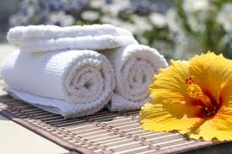
OSHIBORI
Notes:
An oshibori is Japanese for hot towel in English. Oshibori is a wet hand towel offered to customers in places such as restaurants or bars, and used to clean one's hands before eating. The warmth of the towel can relax the facial muscles, increase circulation, open the pores and soften the skin. Plus, it just feels great! Using a warm towel, particularly in times of stress or after a long day can aid in relaxing your nervous system and reducing any tension felt in the face.

Slide 2
KEY FUNCTIONS/DUTIES
1. Pick up the clean white mesh laundry bag washcloths from the Volunteer Services Office at the beginning of the
shift.
2. Fold and roll up clean white washcloths using gloves. Layer the extra clean washcloths in a dry plastic container.
3. Put 2 quarts of water in the bottom part of the chaffing pan/container and plug it in.
4. Check temperature control and make sure it is on “Max”.
5. Place the washcloths for the scheduled areas in the chaffer insert part (1 layer).
6. Place chaffing insert pan over bottom part of the chaffing container.
7. Place one drop of lavender oil on each cloth.
8. Pour hot water over the washcloths in the insert chaffing pan, wetting them (wet them enough that they will stay
wet and not dry out-approximately 1 quart of hot water).
9. Plug in the chaffing pan.
10. Use the small hand held chaffing tray with lid and the tongs when offering towels to the patients.
11. After all visits all containers and equipment must be cleaned and covered for the next day’s use.
12. Place the dirty washcloths in the white mesh laundry bag and leave in the Volunteers Services Office for pick by
Cowell’s Cleaners.

Slide 3
HOSTING OSHIBORI
If you are hosting in a scheduled area:
Prepare the cart for hosting. Place theses items on the cart:
a. Chaffing Dish with Hot Towels
b. Tongs
c. Gloves
d. Tray
e. Laundry Bag
f. CD Player with Spa like Music
2. Offer patient, guest, and/or staff a hot towel.
3.Greet them: “Hi! My name is _____________ from Volunteer Services. Would you like a hot lavender scented towel to refresh yourself?”

Slide 4
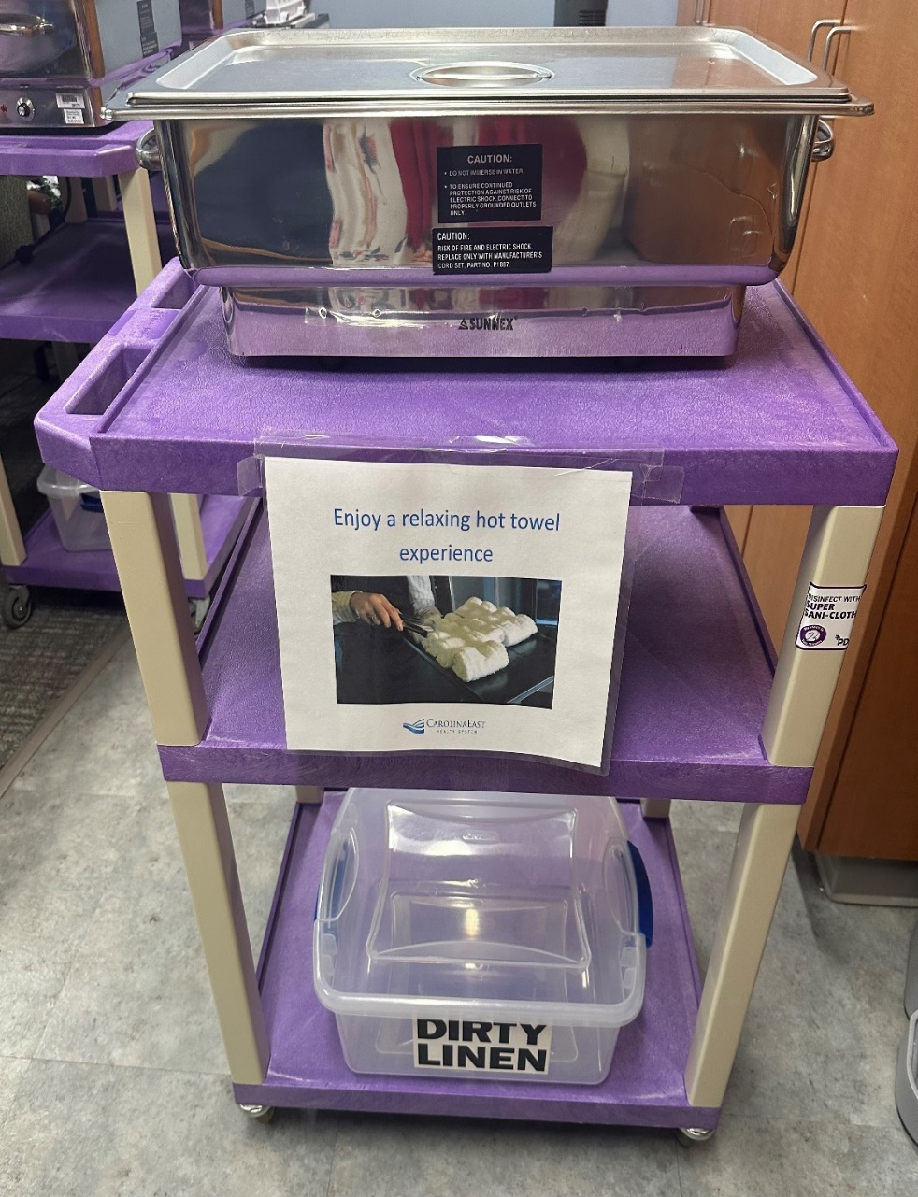
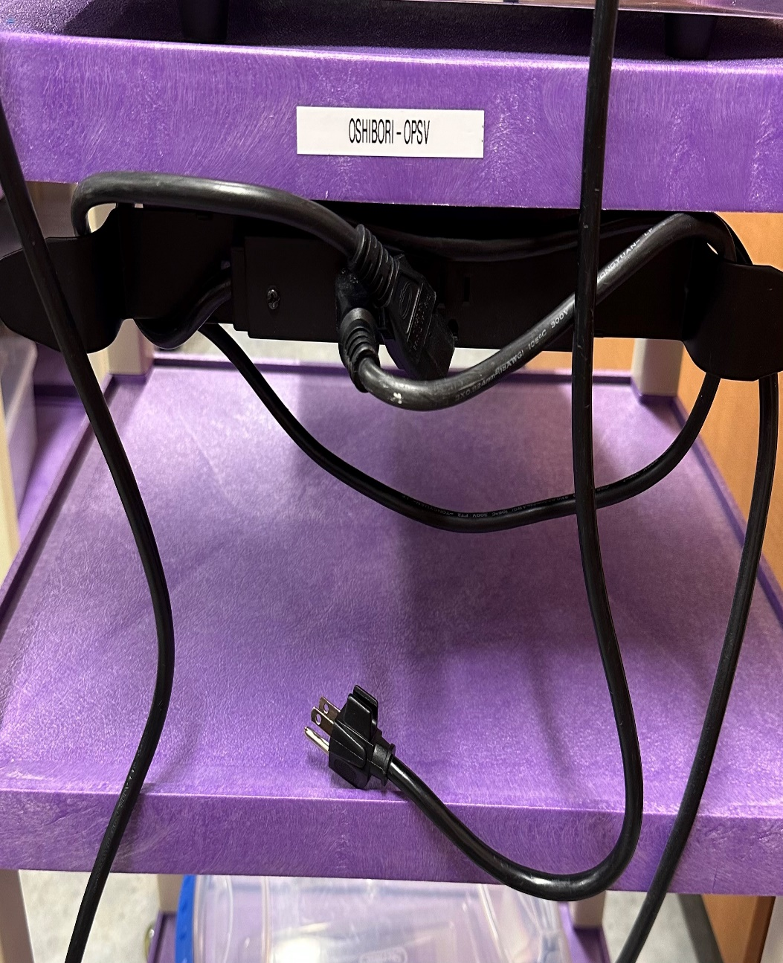
Carts and Locations
Ortho
Nephro
3IMC
Neuro
CDO
SCU
ONC
WOCH
L&D
ICU
IMC
CVIMC
HR
Education
Administration

